Slide 1
Digital Signature System
Willem R. Leonardo
MIS
November 26, 2020

Slide 2
Table of Contents
System Information
Where to go?
Personalize your Stamp
Stamp Information
Home page
How to generate stamp?

Slide 3
1. System Information
Digital Signature System
Is a Electronic stamp that have a system and security that can rely on. It have a unique identification that can be use to verify and to validate every use of it.
This identification have the information of the stamp, on who use the stamp? (user name), where did you generate? (ip address), where did you use (document name), when did you use? (date stamp created).
A stamp can be generate by login in our windows account and the name cannot be change.

Slide 4
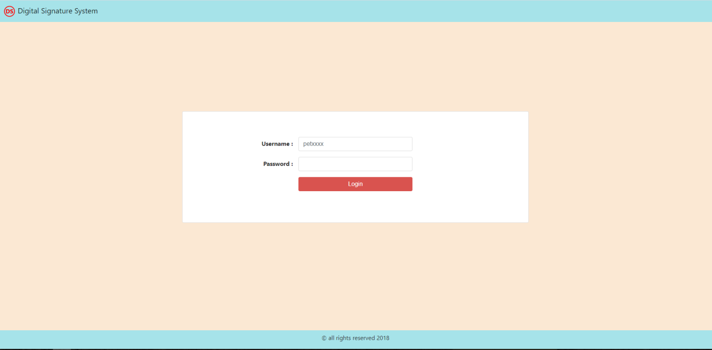
2. Where to go?
To login go to ttp://10.49.1.242:8012/dss/login.php
Then use our windows login account to login.

Slide 5
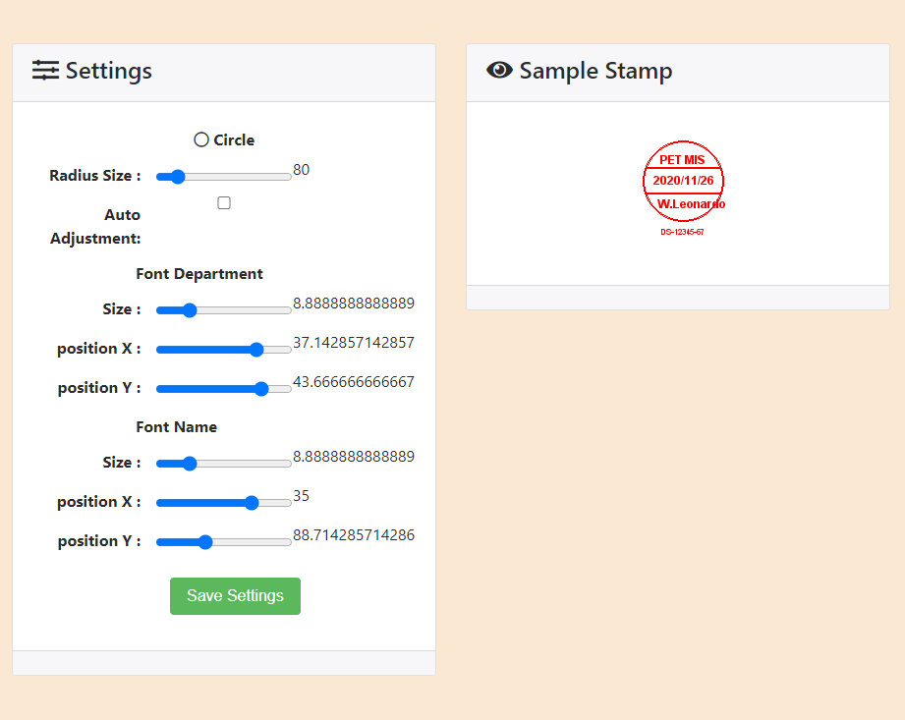
3. Personalize your Stamp
Upon login you specially for the 1st login you will have the opportunity personalize your Stamp.
Just like 8-ban you can set and change the radius of your stamp and place your department and name to proper coordinates specially when your name or last name is so long.
Once your done click save settings.

Slide 6
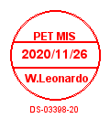
4. Stamp information
Top
- Department Name
Middle
Date stamp create
Bottom
Name of the person that generate the stamp
Stamp Reference no.
NOTE
The name is based on the account that is login on the system

Slide 7
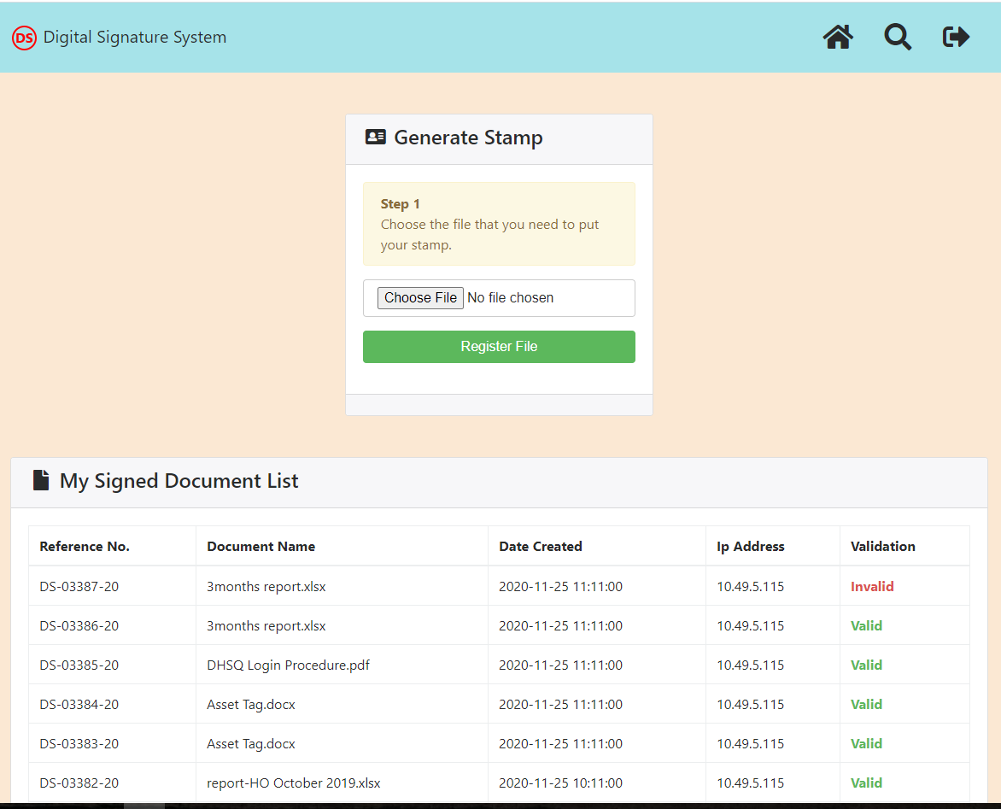
5. Home page

Slide 8
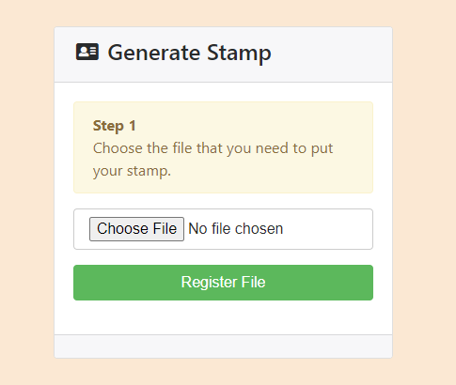
5.1 Home page
Generate Stamp
- This is where you will attach or register your file that you want to put your stamp on

Slide 9
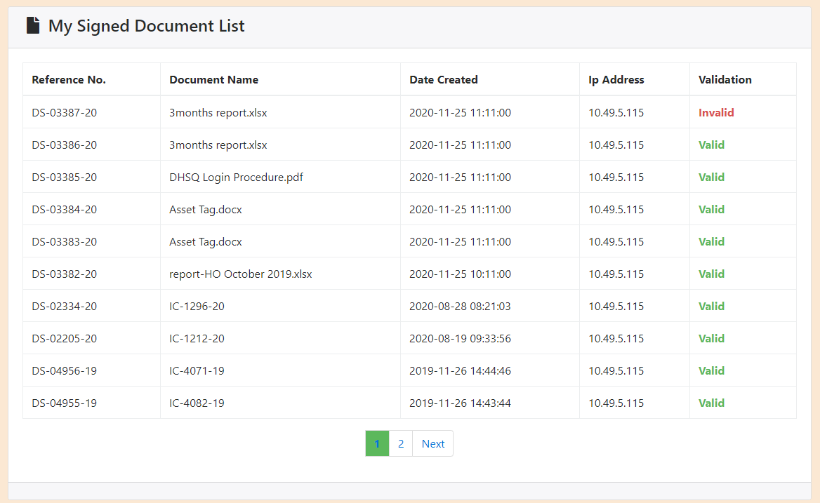
5.2 Home page
My Signed Document List
- This is where you can monitor or check on where did you use your stamp.

Slide 10
How to Generate Stamp?

Slide 11
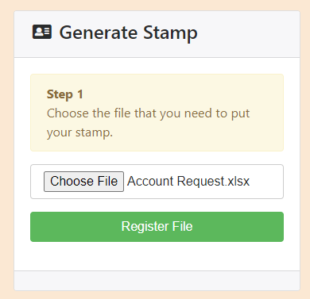
6. How to Generate a Stamp?
Step 1
By clicking the choose file you will be ask to select your file that you want to put your stamp on.
After that click “Register File”.

Slide 12
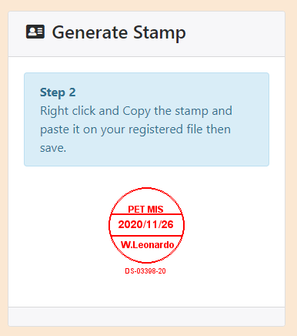
6. How to Generate a Stamp?
Step 2
It will generate the stamp.
Right click then it will prompt you that the stamp will be gone after as seconds and Click copy image.

Slide 13
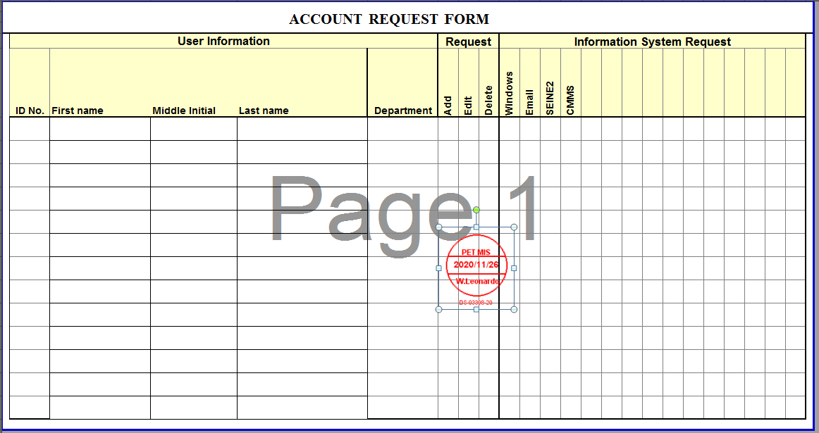
6. How to Generate a Stamp?
Step 2.1
Paste your stamp to your selected file and save it.

Slide 14
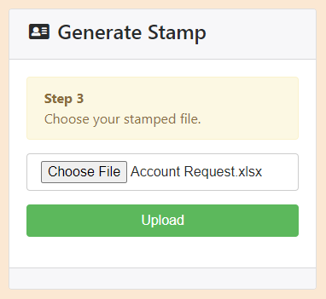
6. How to Generate a Stamp?
Step 3
Click again choose file then select your update file.
After that click “Upload”.

Slide 15
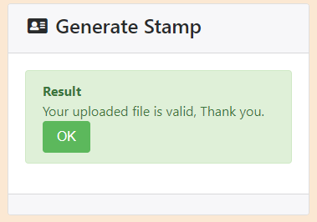
6. How to Generate a Stamp?
Once you upload a right file this information will be shown

Slide 16
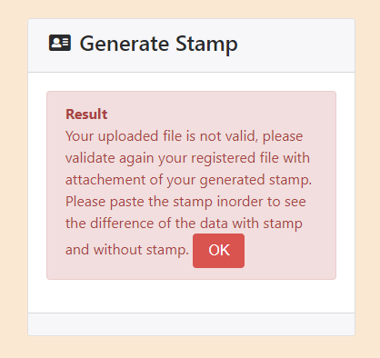
6. How to Generate a Stamp?
Once you upload a right file but did not paste the stamp this error will be shown.

Slide 17
Thank you

Slide 18
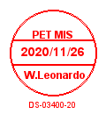
Approve | Checker | Prepared

